Slide 2
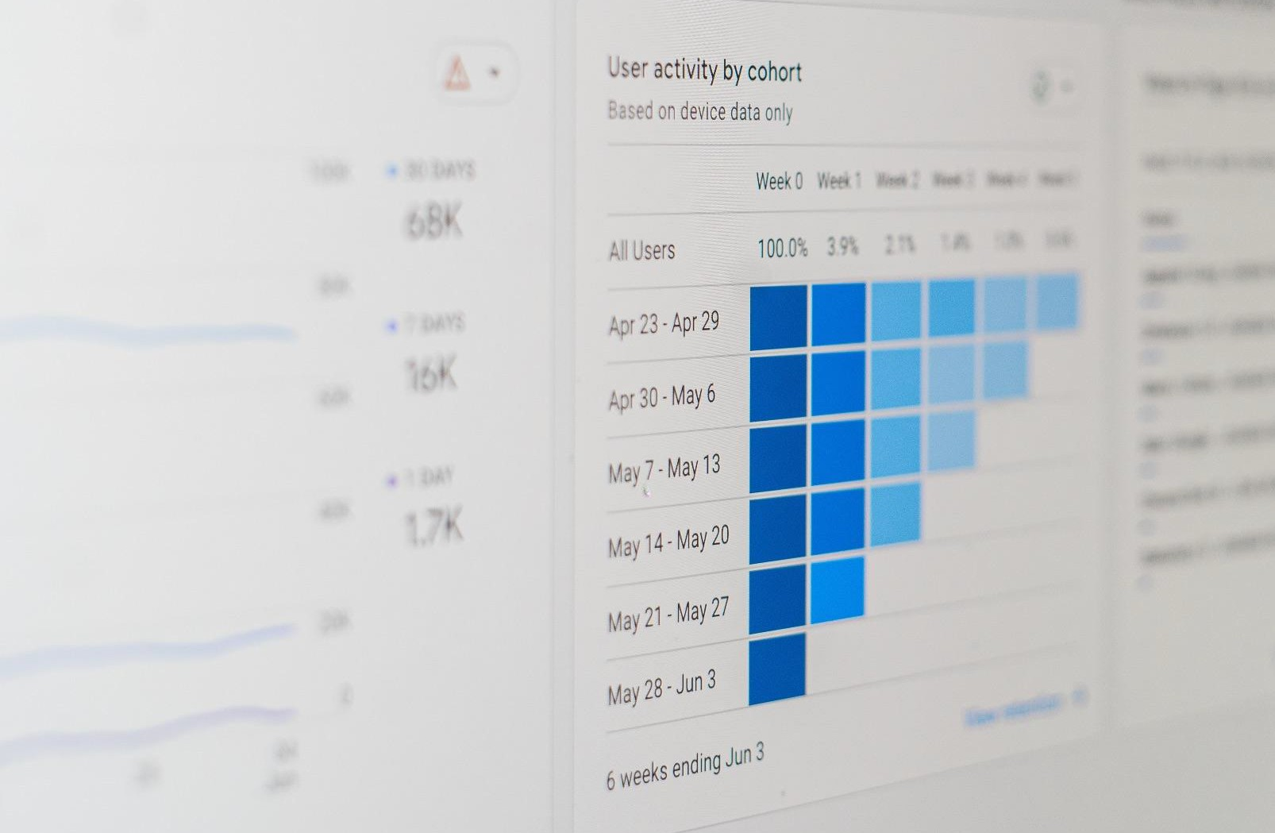
At KrS, our goal is to help public companies reach their maximum potential in regard to all needs related to the business.
We are a full-service platform that enables companies the ability to introduce and/or grow existing business plans in a method that’s not only shareholder friendly but trackable through analytics for the utmost success.

Slide 3
We believe in the value of true marketing.
We have formed a team which ensures no stone is left unturned regardless of the market you are capturing.

Slide 4
Our Team
30+ years of public company experience. Prior CEO of a public company transitioning from insuﬃcient ﬁlings to executing reverse merger, OTC Markets to NYSE uplists, creation of team and vendors providing a magnitude of services speciﬁcally for small cap and microcap markets.
Intimately involved in the identiﬁcation, negotiation and structuring of over 70 individual investments ranging in size from
$1 million to over $25 million in various
industry sectors.
Proven network of investors consisting predominantly of high-net-worth individuals, family oﬃces and smaller institutions.
Financing, corporate restructurings, reverse mergers, along with National Exchange uplists.
Our team thinks outside of the box and provides an all-inclusive experience to make sure your story is told as accurately as possible; representing your business as an extension of our own.

Slide 5
Bachelors: Petroleum Engineering, Political Science, Cyber Security and Criminal Justice
Masters: Data Analytics & Business Administration in Finance
Industry knowledge in Amazon Web Services, Military, O&G, Manufacturing, Banking, Insurance, Marketing, Computer Programming & Analytics, Bankruptcy, Medical and Business entrepreneur.
19 years of computer programming including extensive knowledge of C#, JavaScript, Python, Java, SQL, HTML, PHP and AWS and its components such as VPCs, Lambda functions, IAM roles, HashiCorp's Terraform, APIs and more.
10 years of experience in petroleum production engineering. Ability to digest technical data into market data.

Slide 6
We understand the market is not one size ﬁts all.
Investor Relations Content Creation Data-Driven Analytics Social Media Advocates
Website Creation
Marketing Campaigns
Access to Investor Networks
US and China
Multilingual
English, Chinese & Uzbek available

Slide 7
What to Expect
Through industry knowledge, our team is aware that not every company is the same. Upon contracting and overview of the company, we will formulate a set of recommendations and a plan of execution. Our team will have an overall look into the past and present within the company and create a customizable and actionable plan moving forward.

